Slide 1
Unit 3 – Reference Models

Slide 2
Contents
OSI Reference Model: Architecture, Function of Each Layer
TCP/IP Reference Model: Architecture, Function of Layers
Comparison of OSI & TCP/IP Models

Slide 3
OSI Reference Model: Architecture, Function of Each Layer
Layered Tasks
We use the concept of layers in our daily life. As an example, let us consider two friends who communicate through postal mail.
The process of sending a letter to a friend would be complex if there were no services available from the post office.

Slide 4
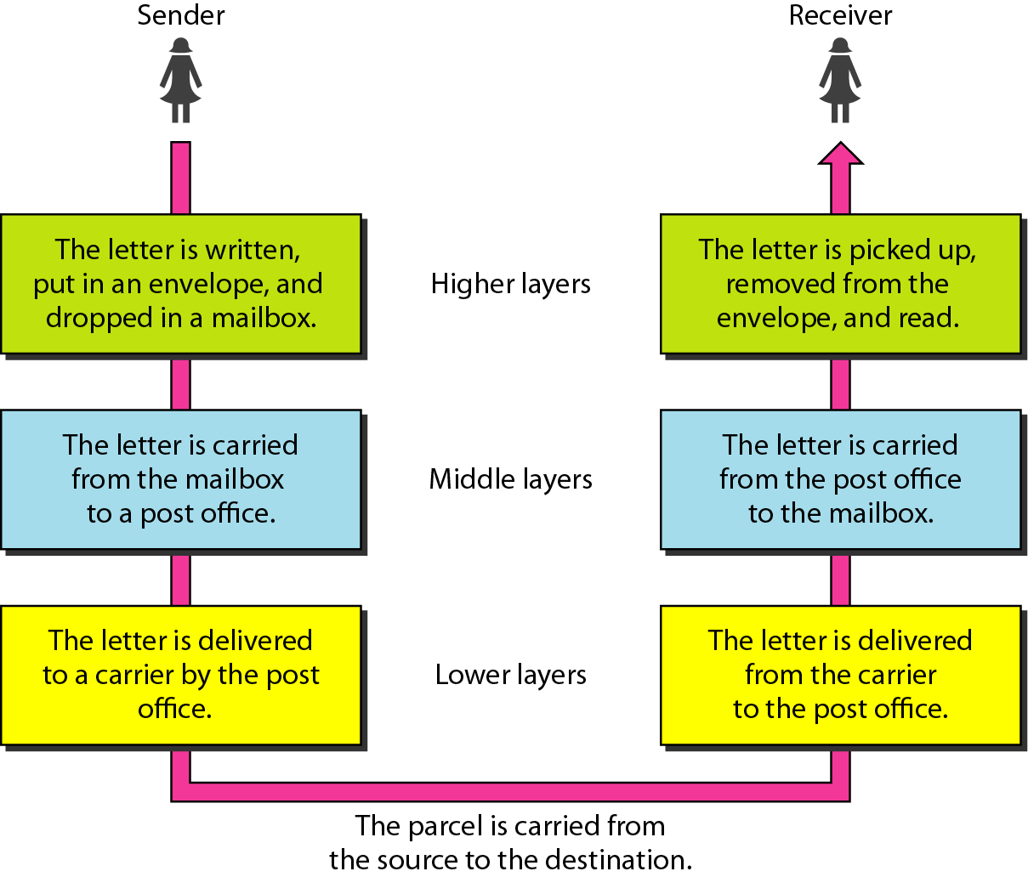
OSI Reference Model: Architecture, Function of Each Layer

Slide 5
OSI Reference Model: Architecture, Function of Each Layer
THE OSI MODEL
Established in 1947, the International Standards Organization (ISO) is a multinational body dedicated to worldwide agreement on international standards. An ISO standard that covers all aspects of network communications is the Open Systems Interconnection (OSI) model. It was first introduced in the late 1970s.
ISO is the organization. OSI is the model.

Slide 6
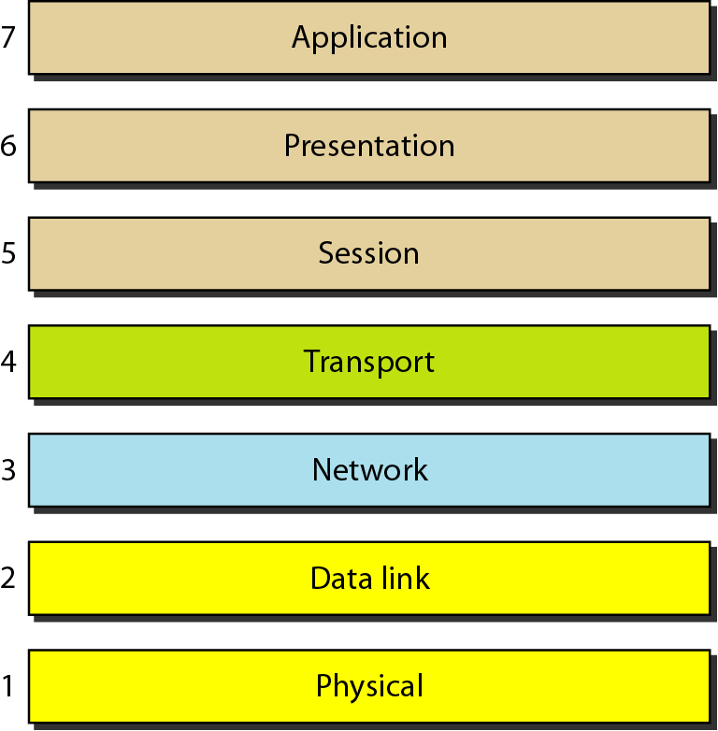
OSI Reference Model: Architecture, Function of Each Layer

Slide 7
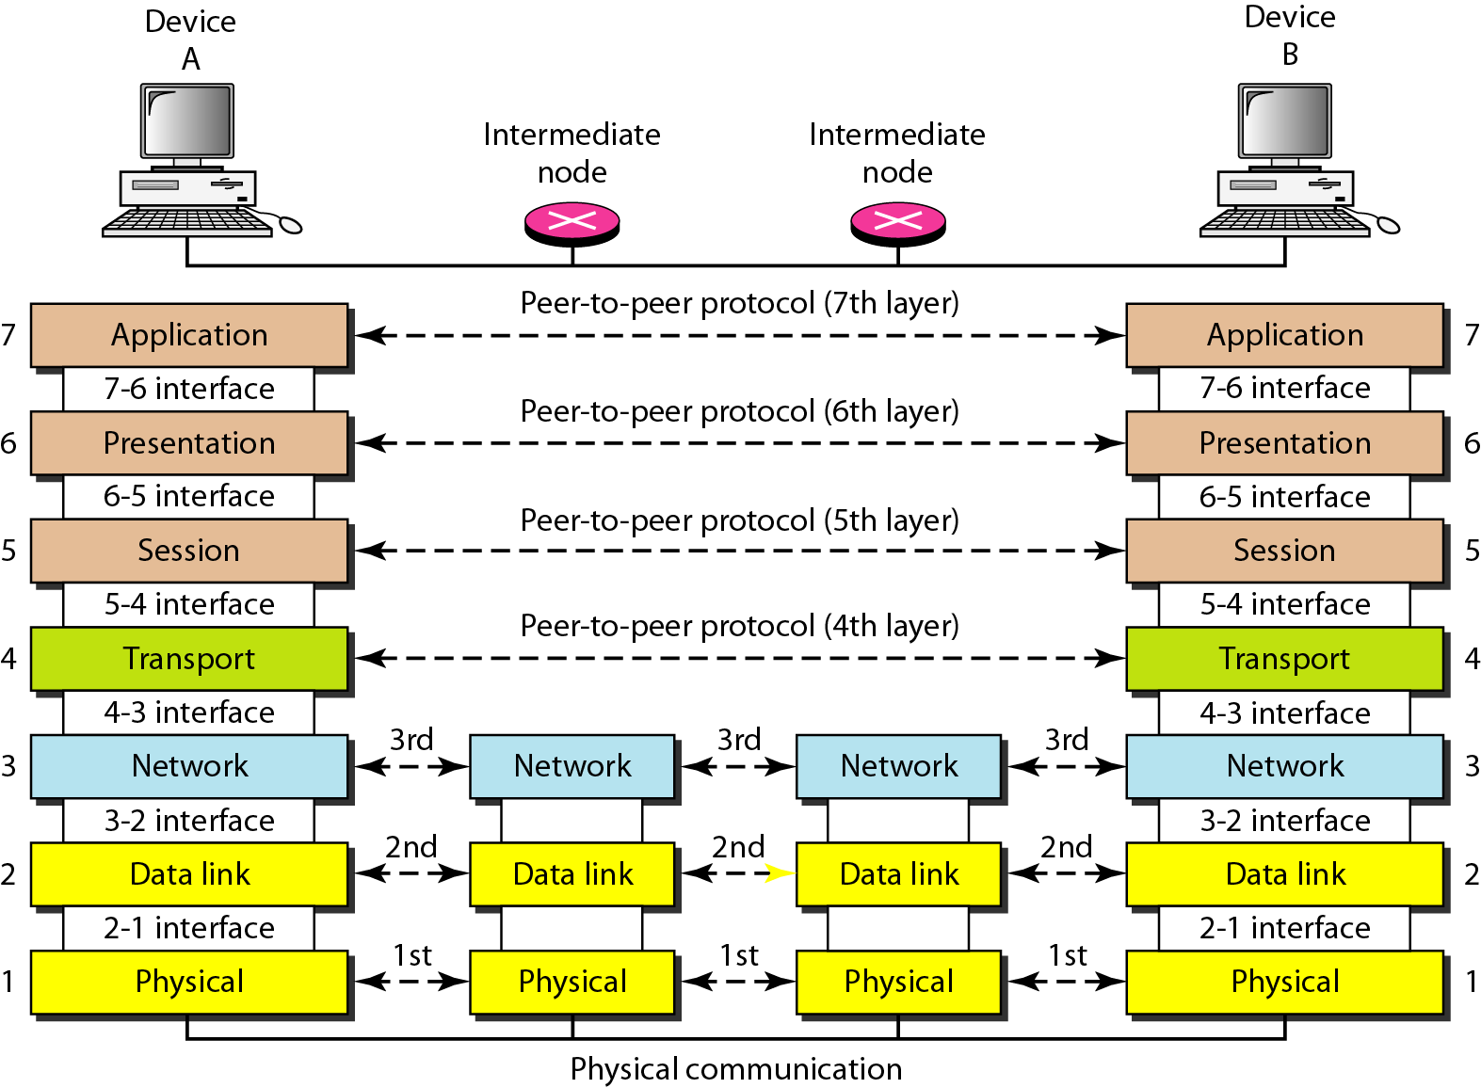
OSI Reference Model: Architecture, Function of Each Layer

Slide 8
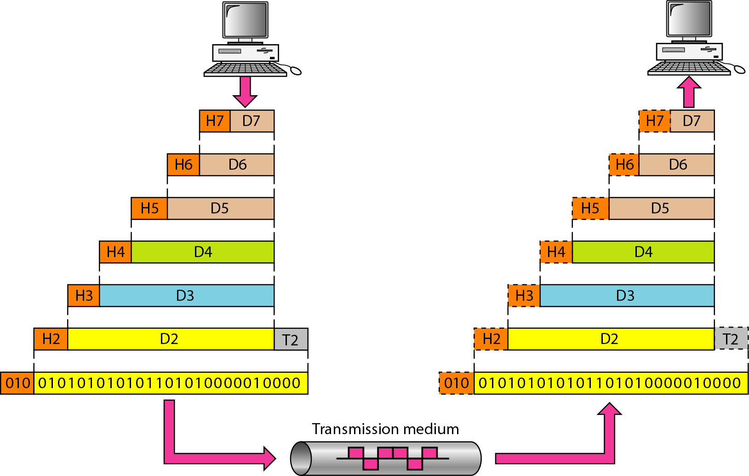
OSI Reference Model: Architecture, Function of Each Layer

Slide 9
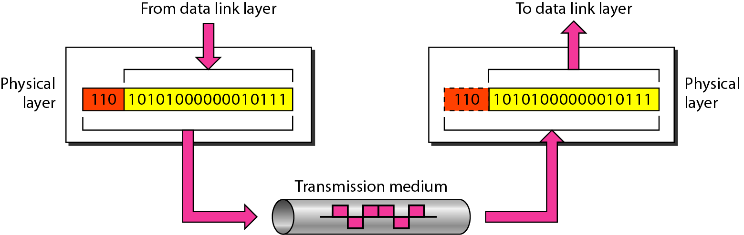
OSI Reference Model: Architecture, Function of Each Layer
LAYERS IN THE OSI MODEL
Physical layer
The physical layer is responsible for movements of
individual bits from one hop (node) to the next.

Slide 10
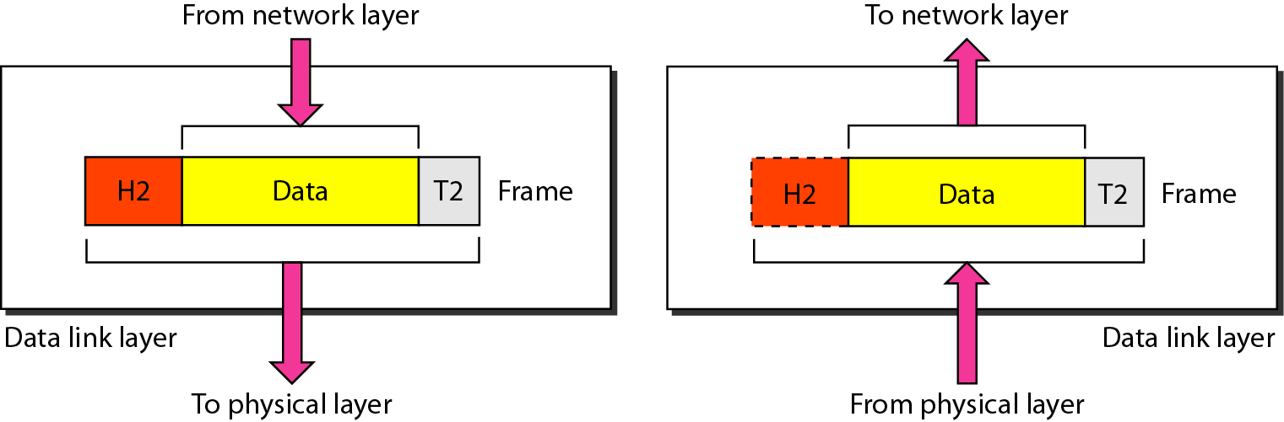
OSI Reference Model: Architecture, Function of Each Layer
Data Link Layer
The data link layer is responsible for moving frames from one hop (node) to the next.

Slide 11
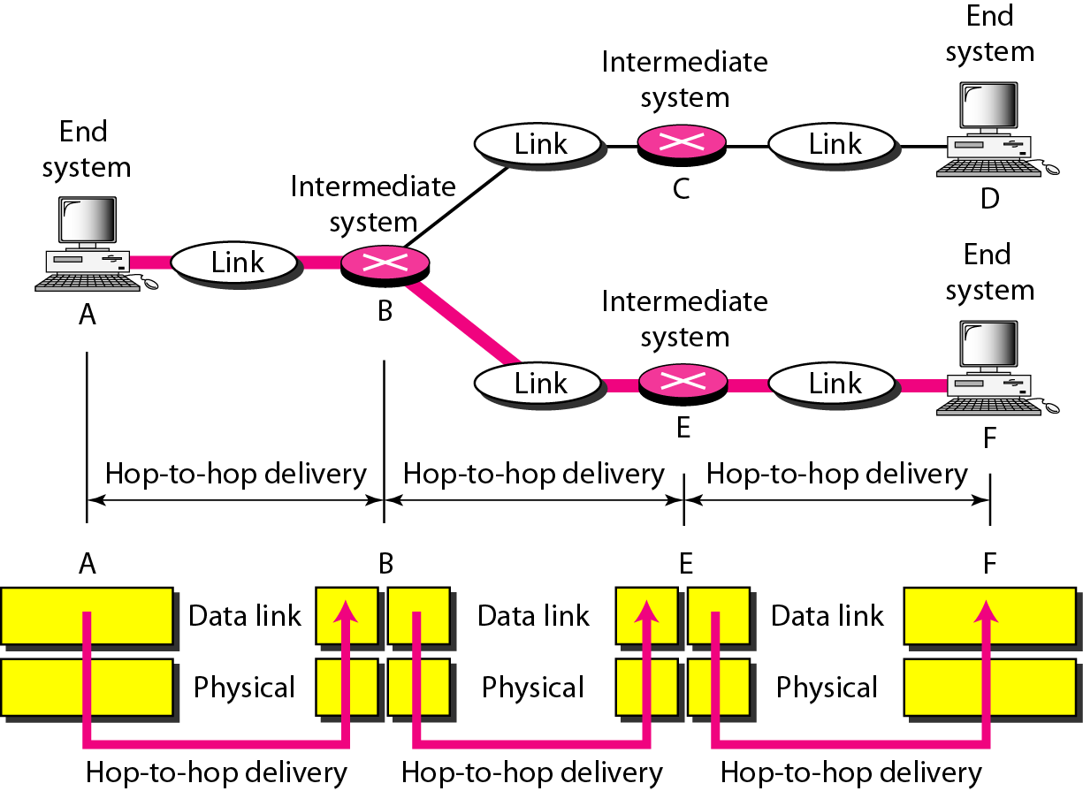
OSI Reference Model: Architecture, Function of Each Layer
Hop-to-hop delivery

Slide 12
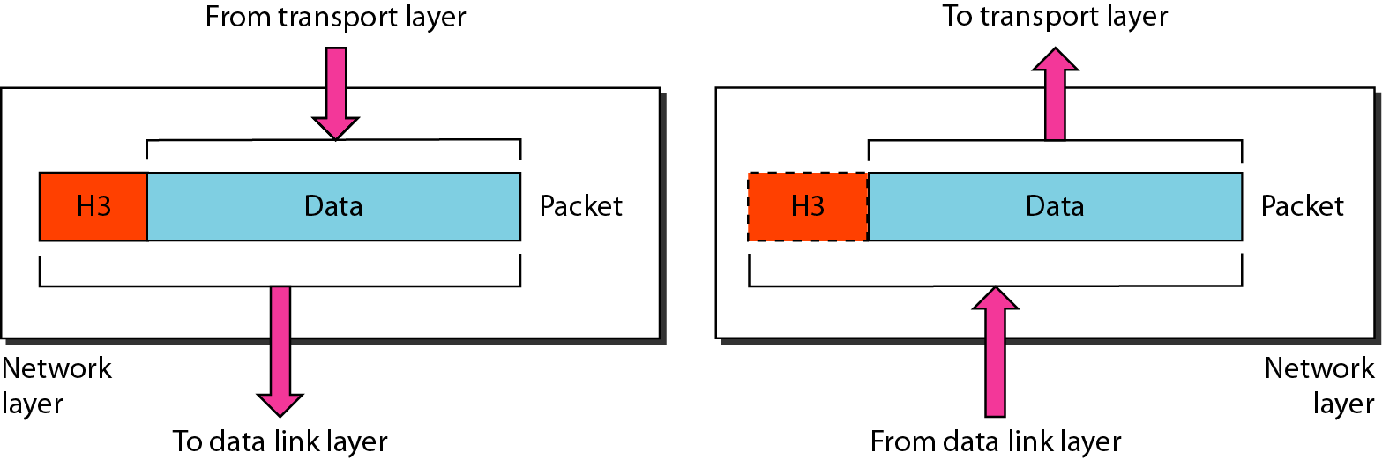
OSI Reference Model: Architecture, Function of Each Layer
Network Layer
The network layer is responsible for the delivery of individual packets from
the source host to the destination host.

Slide 13
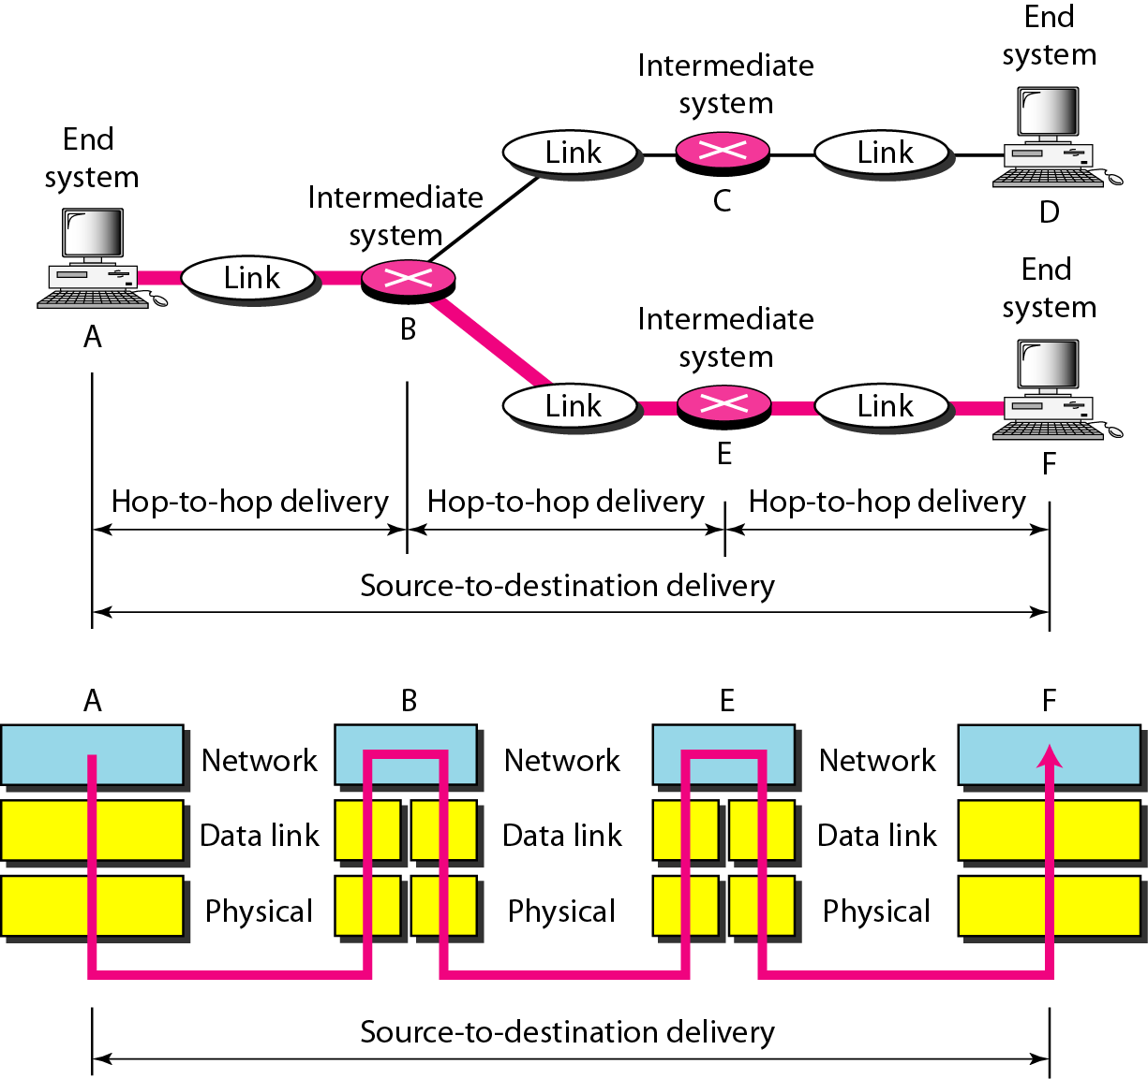
OSI Reference Model: Architecture, Function of Each Layer
Source-to-destination delivery

Slide 14
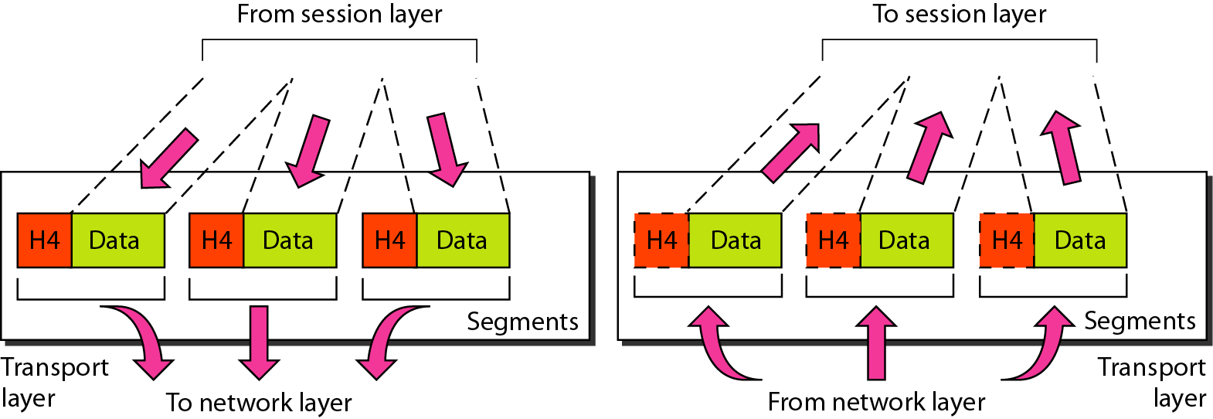
OSI Reference Model: Architecture, Function of Each Layer
Transport layer
The transport layer is responsible for the delivery of a message from one process to another.

Slide 15
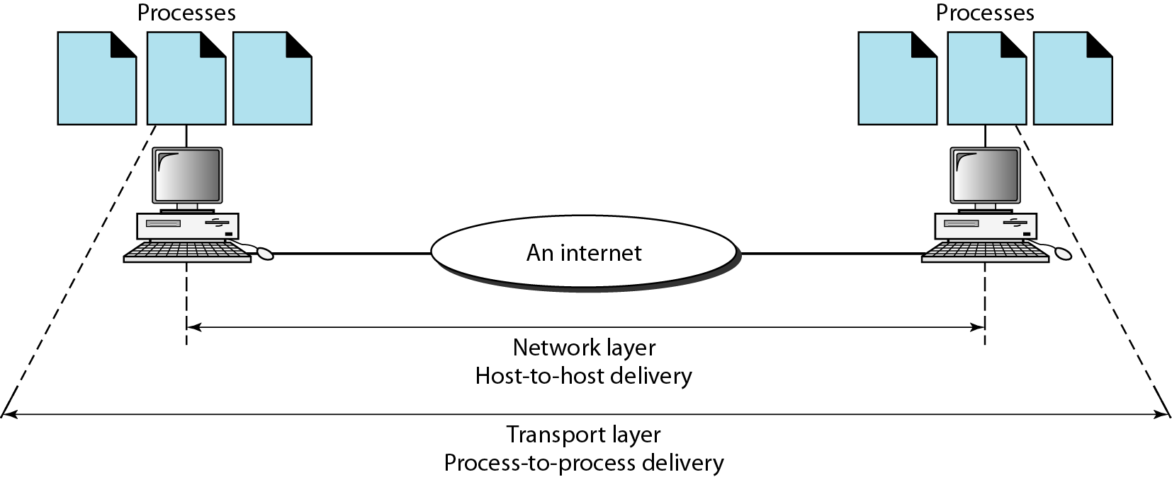
OSI Reference Model: Architecture, Function of Each Layer
Reliable process-to-process delivery of a message

Slide 16
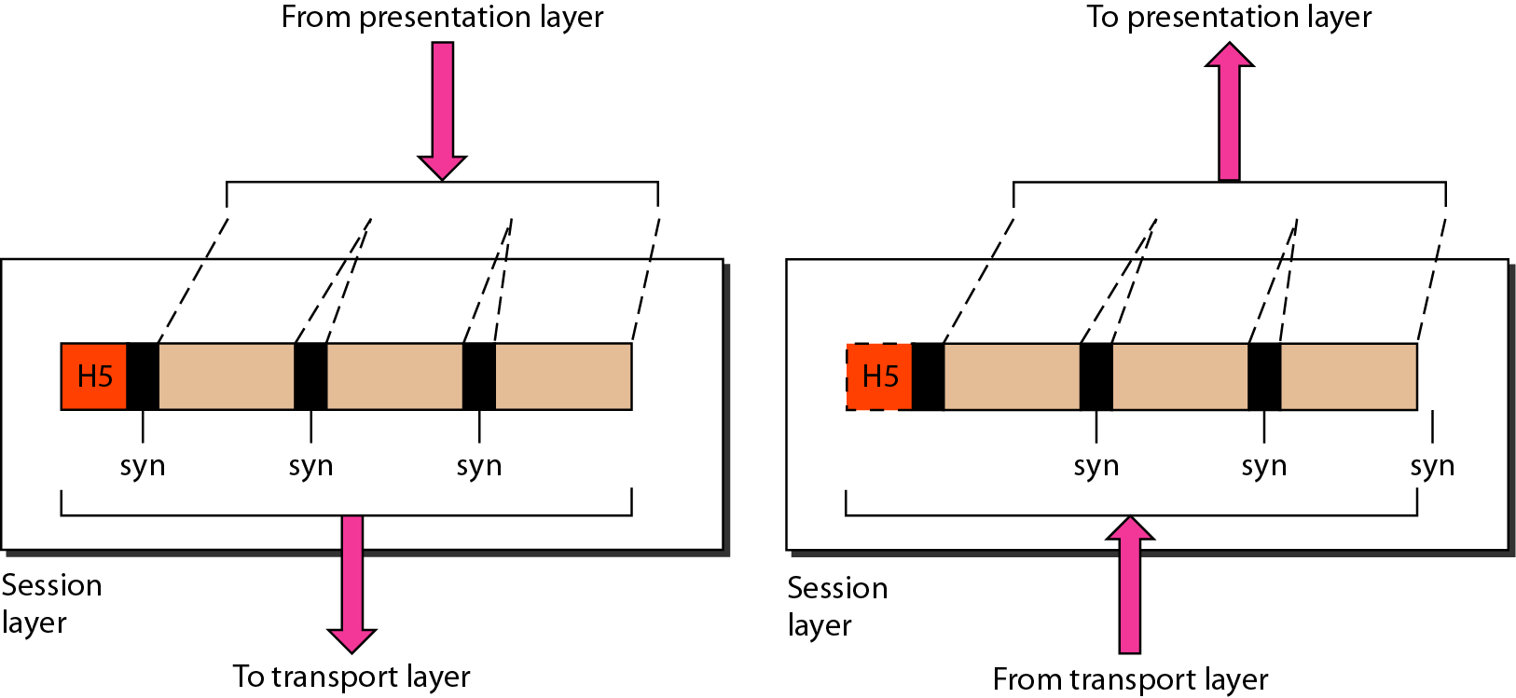
OSI Reference Model: Architecture, Function of Each Layer
Session layer
The session layer is responsible for dialog control and synchronization.

Slide 17
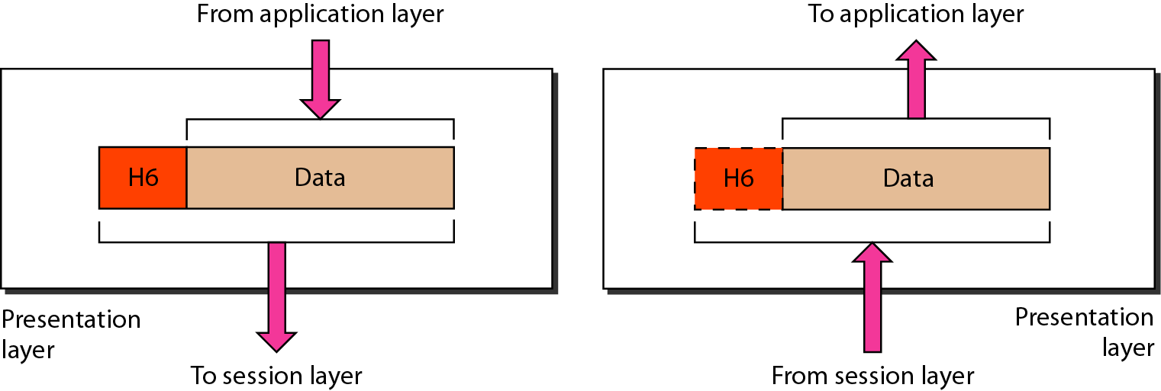
OSI Reference Model: Architecture, Function of Each Layer
Presentation layer
The presentation layer is responsible for translation, compression, and encryption.

Slide 18
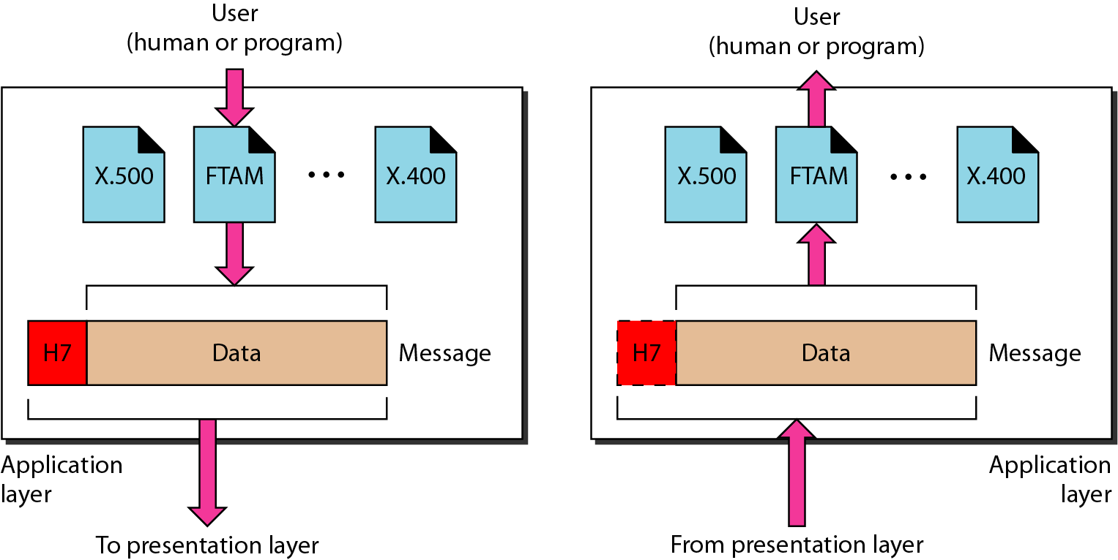
OSI Reference Model: Architecture, Function of Each Layer
Application layer
The application layer is responsible for providing services to the user.

Slide 19
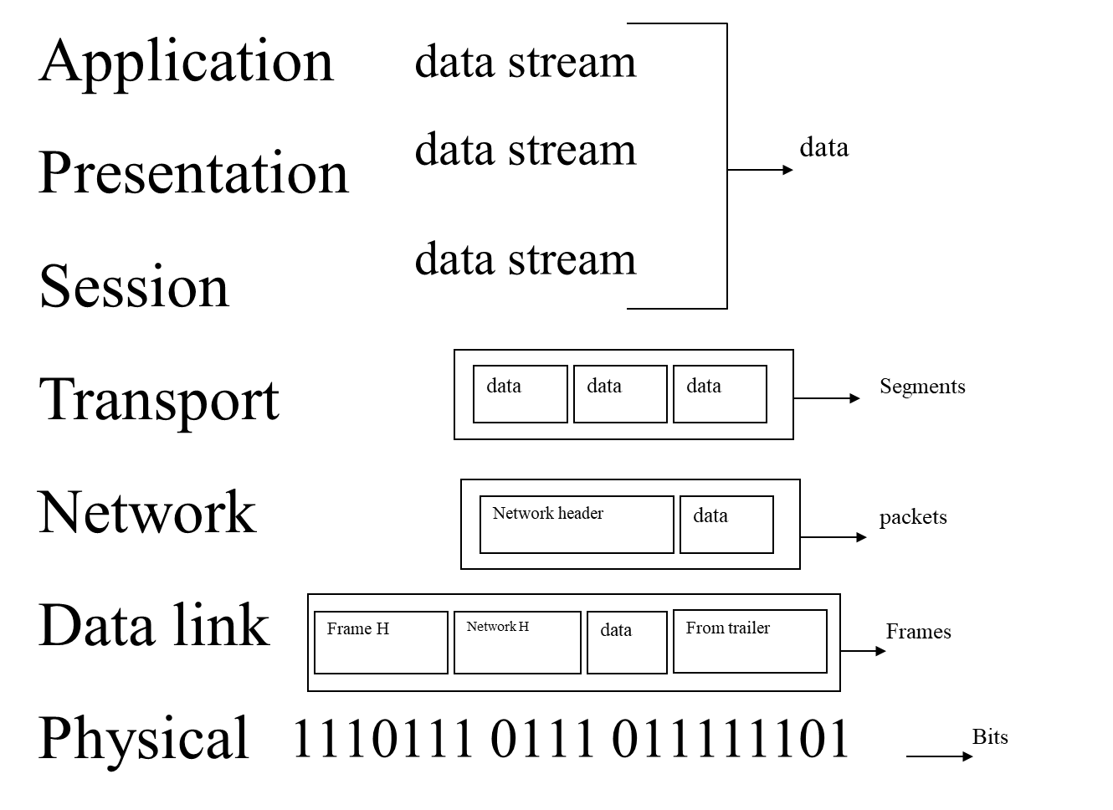
OSI Reference Model: Architecture, Function of Each Layer

Slide 20
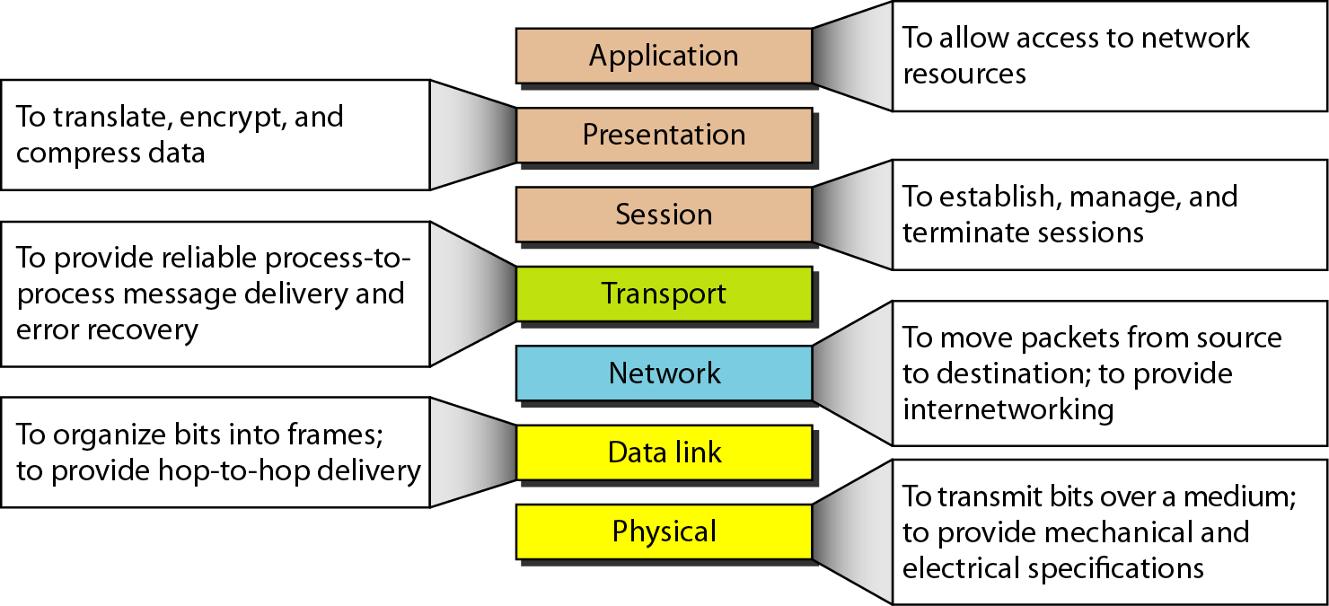
OSI Reference Model: Architecture, Function of Each Layer
Summary of layers

Slide 21
Contents
OSI Reference Model: Architecture, Function of Each Layer
TCP/IP Reference Model: Architecture, Function of Layers
Comparison of OSI & TCP/IP Models

Slide 22
TCP/IP Reference Model: Architecture, Function of Layers
The layers in the TCP/IP protocol suite do not exactly match those in the OSI model.
The original TCP/IP protocol suite was defined as having four layers: host-to-network, internet, transport, and application.
However, when TCP/IP is compared to OSI, we can say that the TCP/IP protocol suite is made of five layers: physical, data link, network, transport, and application.

Slide 23
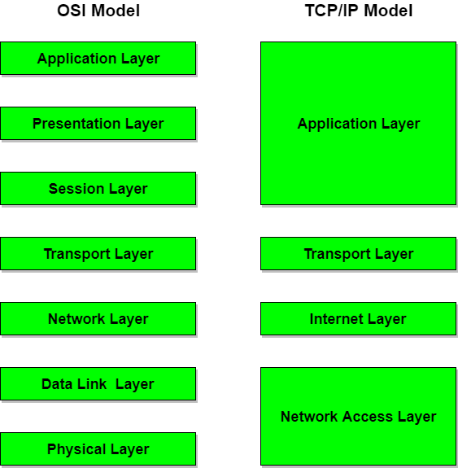
TCP/IP Reference Model: Architecture, Function of Layers
The TCP/IP protocol suite is a hierarchical protocol , made of four layers:
Network Access layer
Internet layer
Transport layer
Application layer

Slide 24
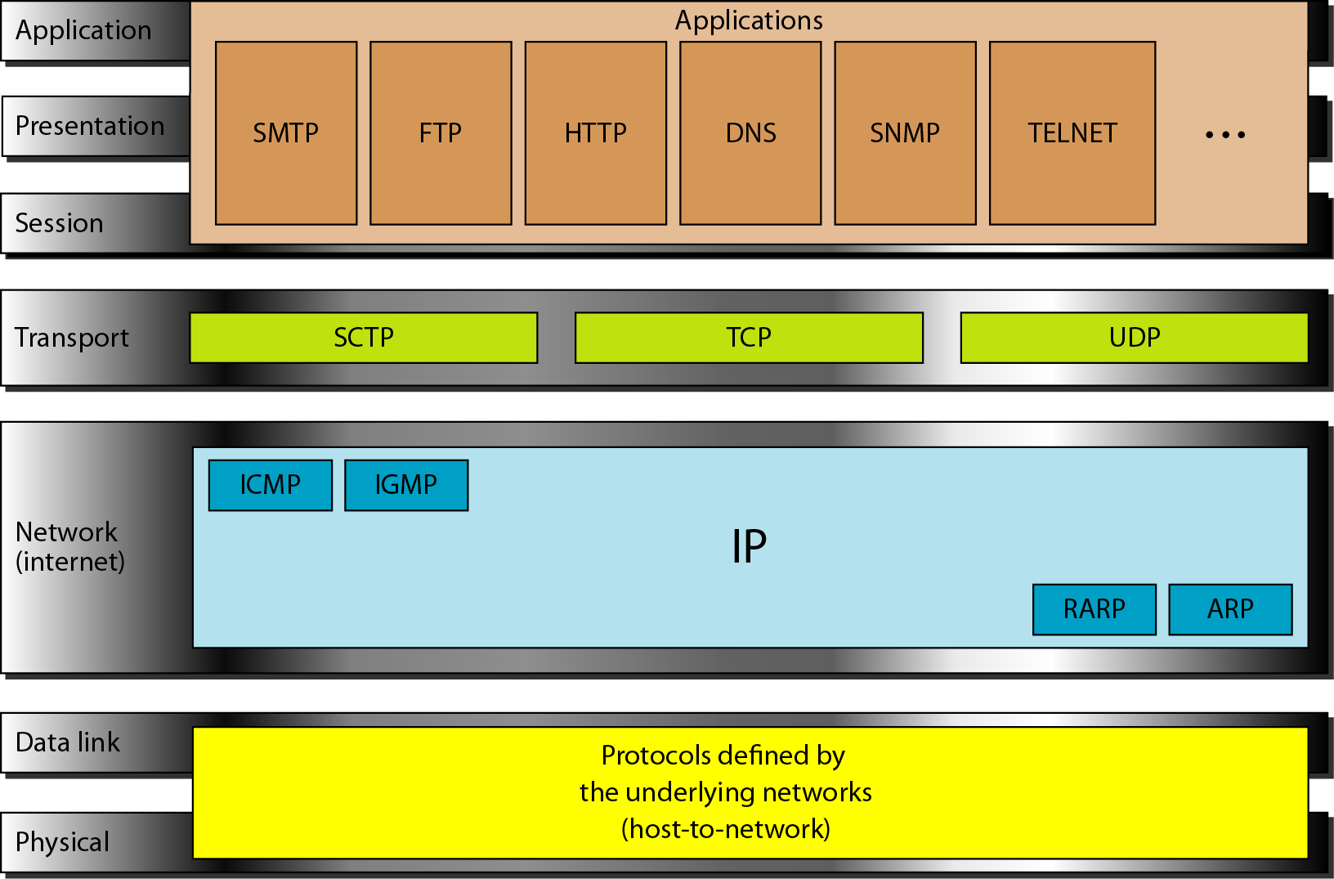
TCP/IP Reference Model: Architecture, Function of Layers

Slide 25
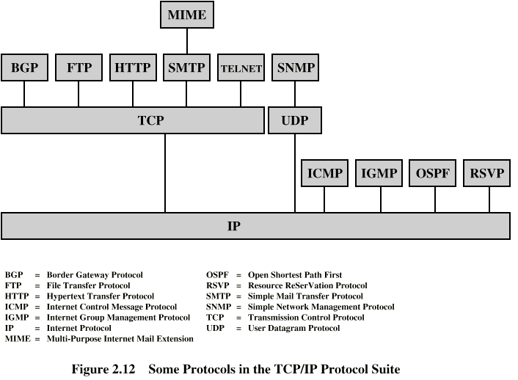
TCP/IP Reference Model: Architecture, Function of Layers

Slide 26
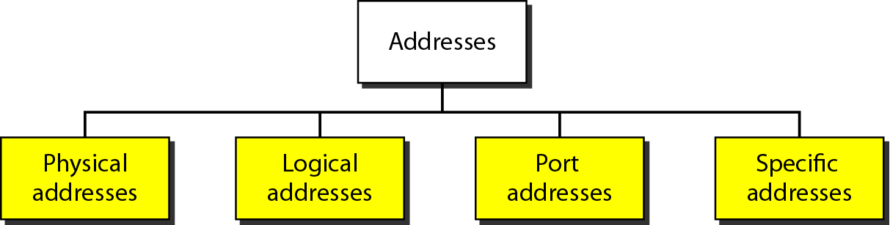
TCP/IP Reference Model: Architecture, Function of Layers
Four levels of addresses are used in an internet employing the TCP/IP protocols: physical, logical, port, and specific.

Slide 27
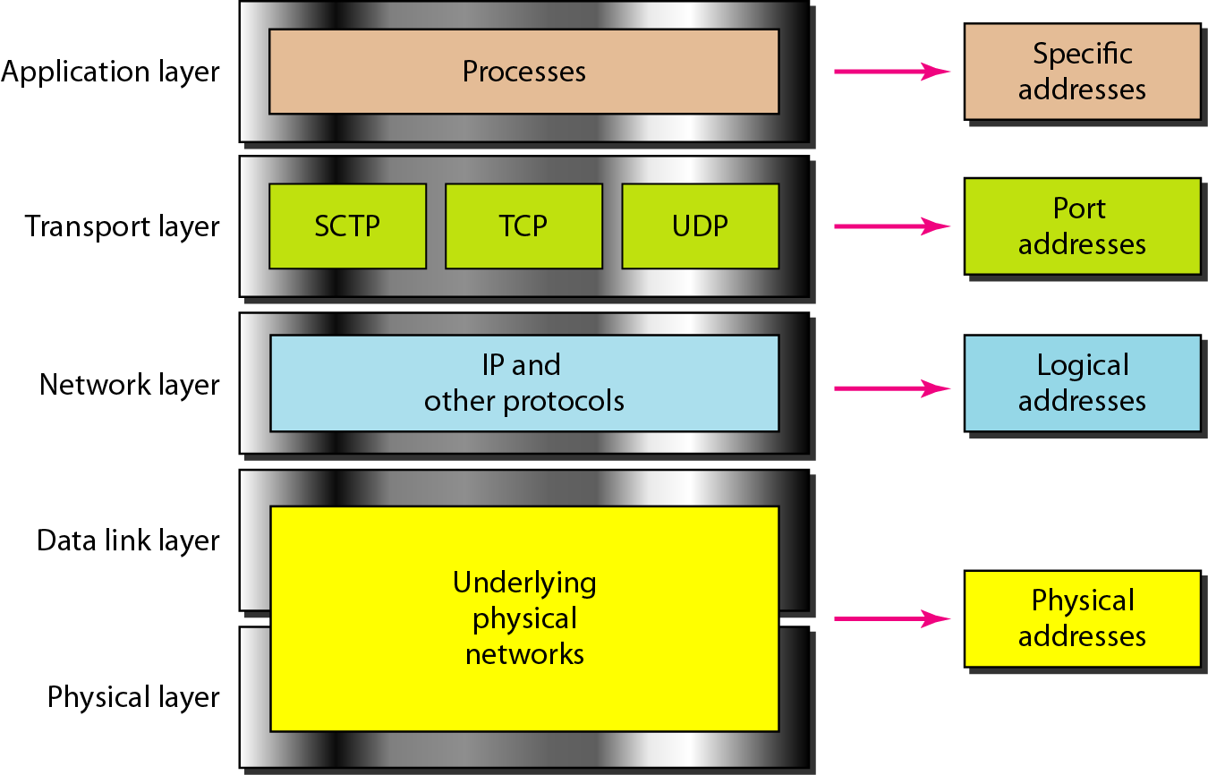
TCP/IP Reference Model: Architecture, Function of Layers
Relationship of layers and addresses in TCP/IP

Slide 28
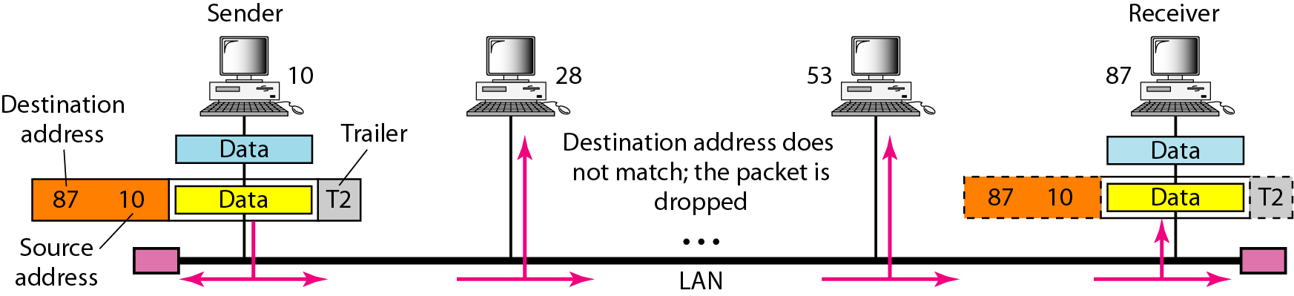
TCP/IP Reference Model: Architecture, Function of Layers
In following figure a node with physical address 10 sends a frame to a node with physical address 87.
The two nodes are connected by a link (bus topology LAN). As the figure shows, the computer with physical address 10 is the sender, and the computer with physical address 87 is the receiver.

Slide 29
TCP/IP Reference Model: Architecture, Function of Layers
Most local-area networks use a 48-bit (6-byte) physical address written as 12 hexadecimal digits; every byte (2 hexadecimal digits) is separated by a colon, as shown below:
07:01:02:01:2C:4B
A 6-byte (12 hexadecimal digits) physical address.

Slide 30
TCP/IP Reference Model: Architecture, Function of Layers
Figure shows a part of an internet with two routers connecting three LANs. Each device (computer or router) has a pair of addresses (logical and physical) for each connection.
In this case, each computer is connected to only one link and therefore has only one pair of addresses.
Each router, however, is connected to three networks (only two are shown in the figure).
So each router has three pairs of addresses, one for each connection.

Slide 31
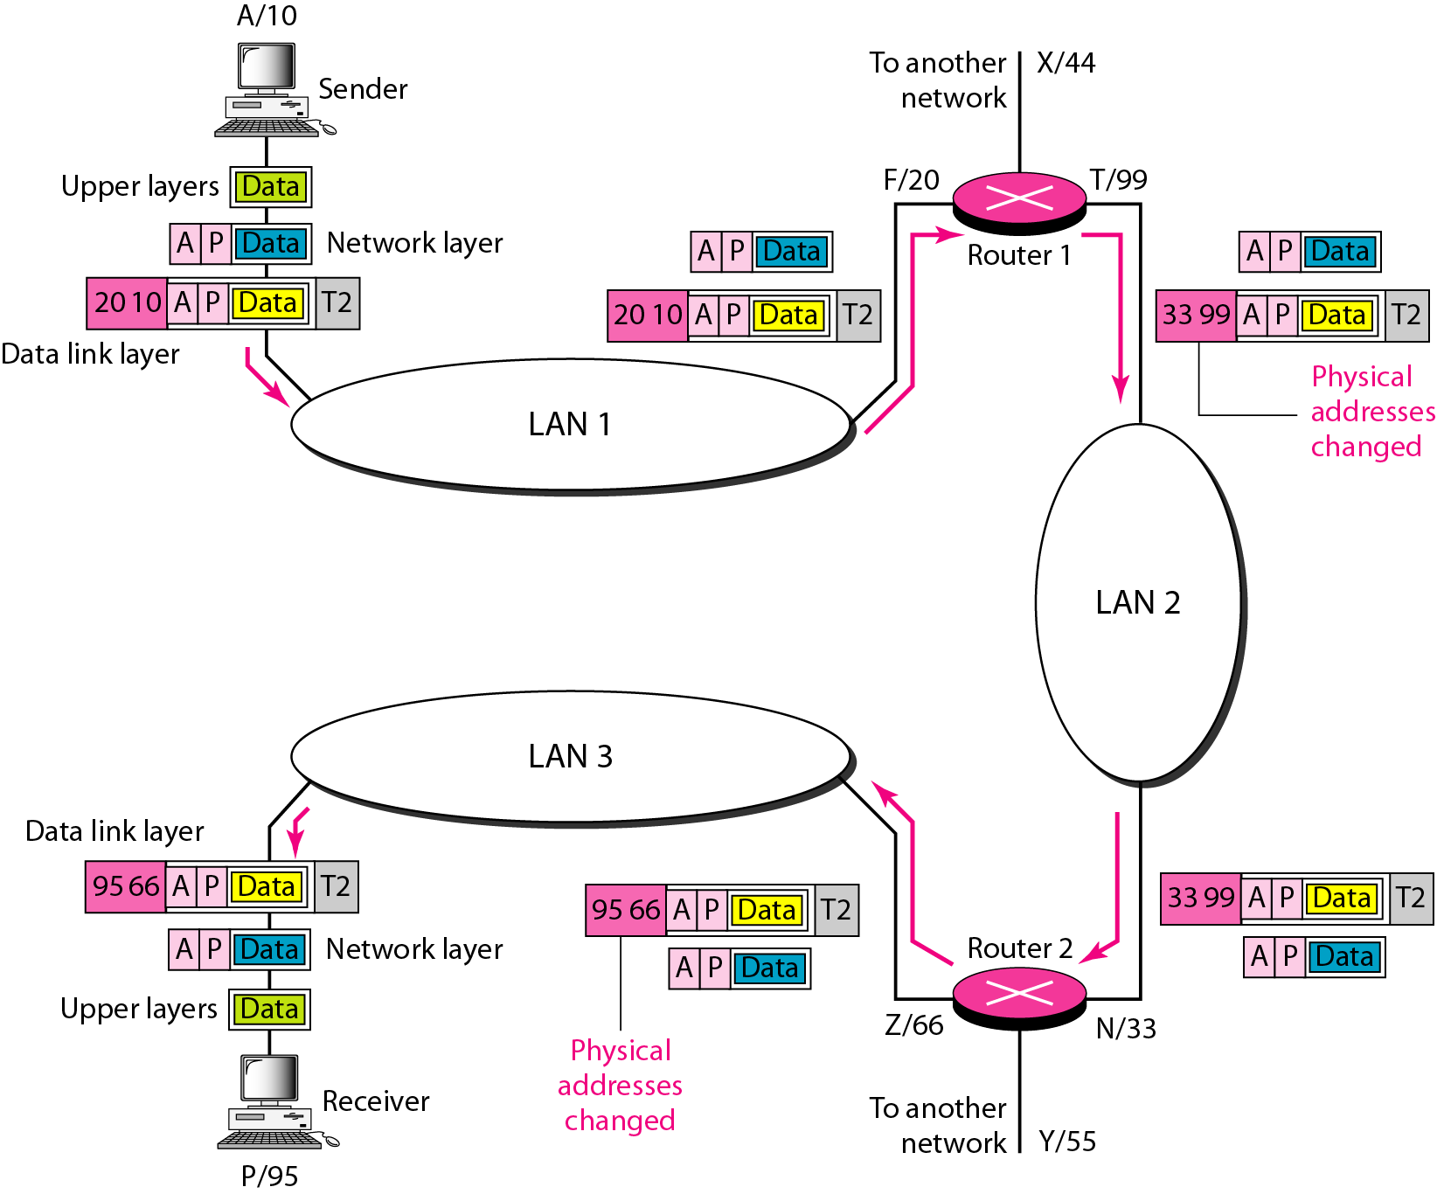
TCP/IP Reference Model: Architecture, Function of Layers
IP address

Slide 32
TCP/IP Reference Model: Architecture, Function of Layers
Figure shows two computers communicating via the Internet.
The sending computer is running three processes at this time with port addresses a, b, and c.
The receiving computer is running two processes at this time with port addresses j and k.
Process a in the sending computer needs to communicate with process j in the receiving computer.
Note that although physical addresses change from hop to hop, logical and port addresses remain the same from the source to destination.

Slide 33
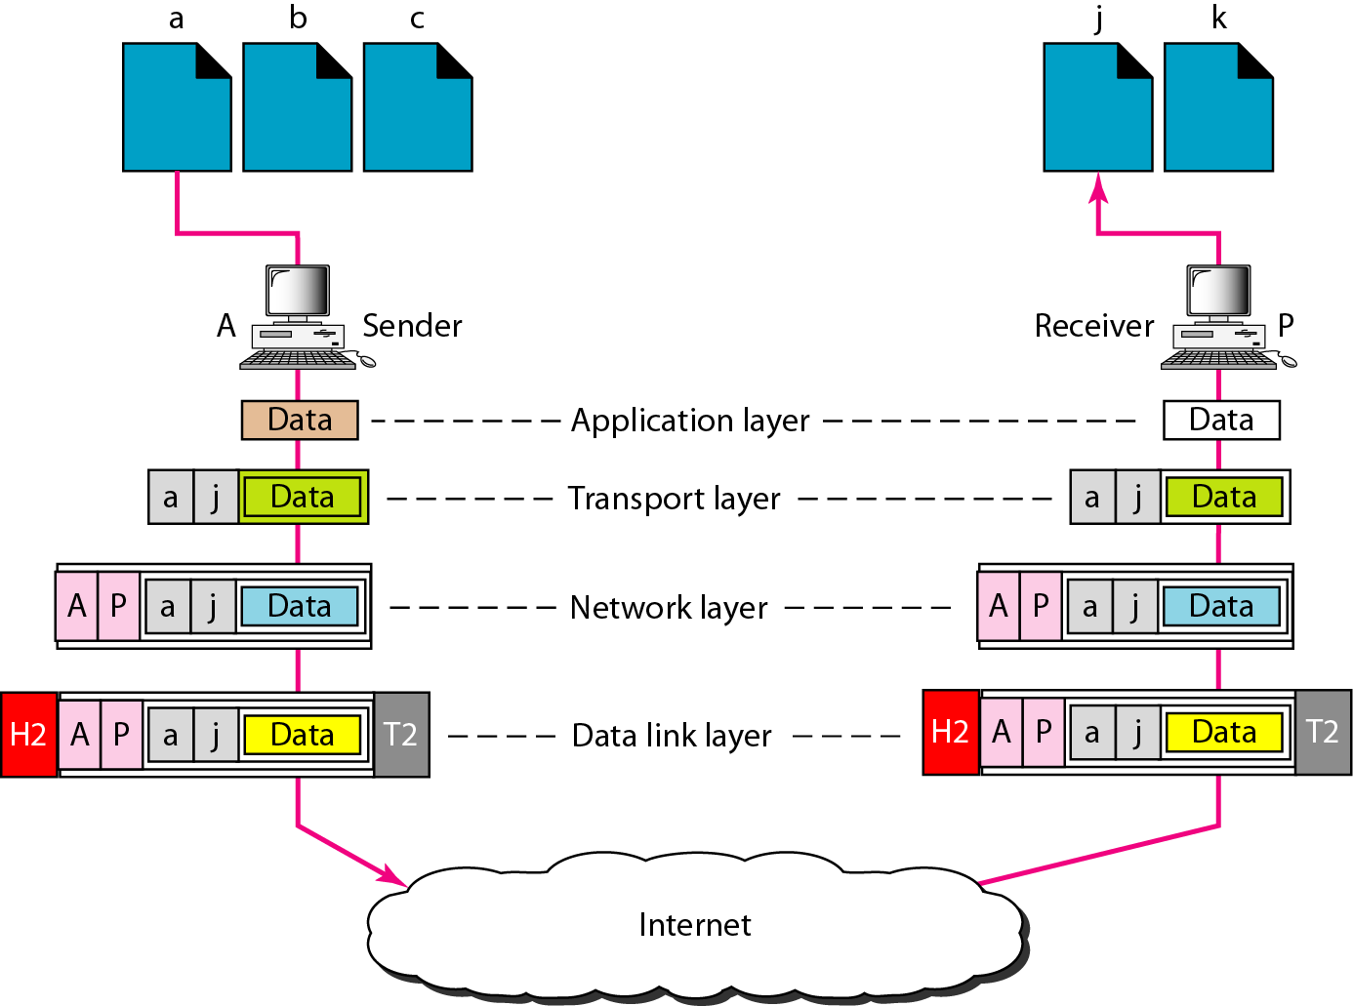
TCP/IP Reference Model: Architecture, Function of Layers
Port address

Slide 34
TCP/IP Reference Model: Architecture, Function of Layers
The physical addresses will change from hop to hop,
but the logical addresses usually remain the same.

Slide 35
TCP/IP Reference Model: Architecture, Function of Layers
A port address is a 16-bit address represented by one decimal number as shown.
753
A 16-bit port address represented as one single number.

Slide 36
Contents
OSI Reference Model: Architecture, Function of Each Layer
TCP/IP Reference Model: Architecture, Function of Layers
Comparison of OSI & TCP/IP Models

Slide 37
Comparison of OSI & TCP/IP Models
Session and presentation layers of OSI model are not part of TCP/IP model as they were not added to TCP/IP model after OSI model was published.
Application layer in TCP/IP is combination of three layers, application, presentation and session layers.
Application layer is a single software, many applications can be developed at this layer.
In some cases application also requires functionalities from session or presentation layer, hence they are merged.

Slide 38
Comparison of OSI & TCP/IP Models
Lack of OSI model’s success
When OSI model came out TCP/IP was already in place and significant time and money were invested in it.
Some layers of OSI model were not fully defined. E.g. Session and presentation layer’s protocols were not clear.
When OSI was implemented in a different applications, it did not reach the performance criteria required by the Internet authority.

